Slide 1
primer to python for astronomers
Imran s Hasan

Slide 2
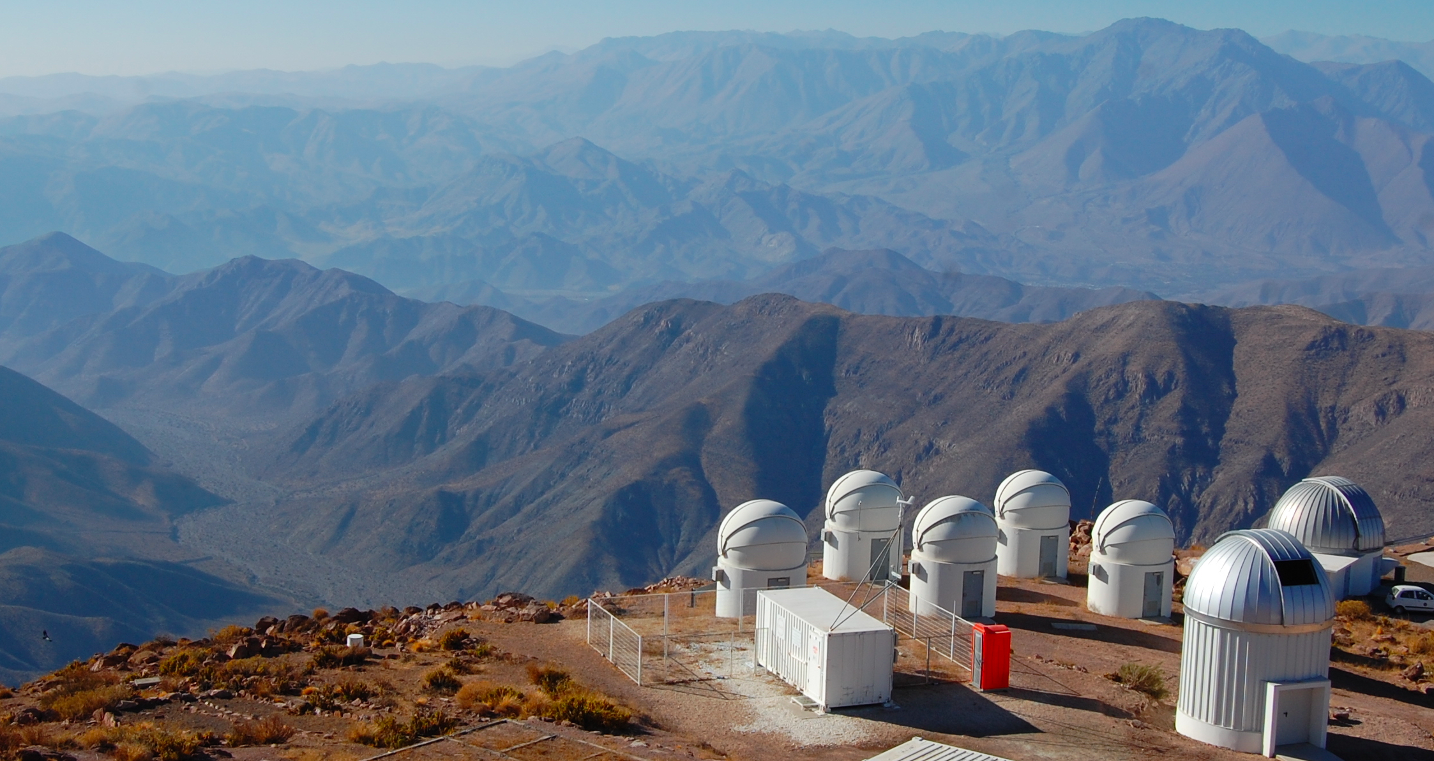
Small telescopes
Organize observing plans
Process/Distribute/Archive data
Develop & Maintain pipelines
Long term behavior of black holes
Share data with the world

Slide 3
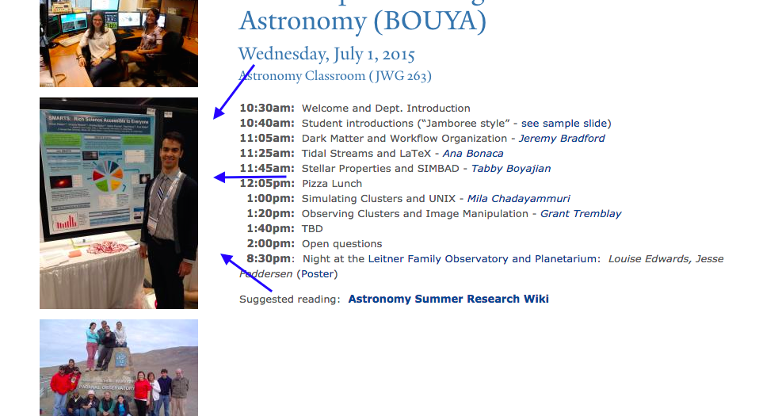
Cool story bro
You may also recognize me as that cool guy
In the picture for the boot camp website

Slide 4
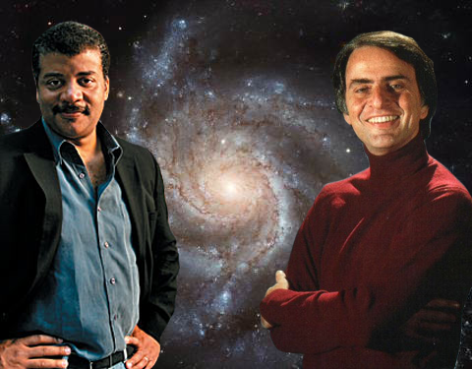
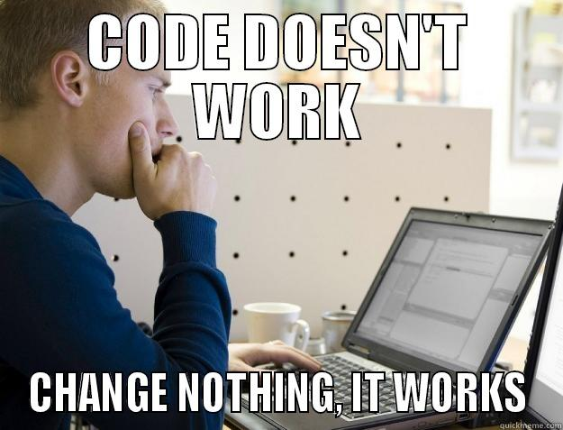
I’m an astronomer…
What I think I do
What I really do

Slide 5
Coding in astronomy
Almost all professional astronomers code! Our data are almost always digital (detector data, simulations)
Most widely used languages today are probably Python, IDL, and Fortran
A lot of legacy code is written in older languages like Fortran, C, C++ from back in the day
The community is brimming with collaborative projects. Chances are you will use one this summer

Slide 6
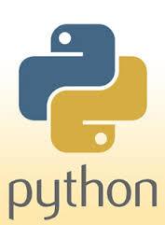
Why use python?
Python is free, other languages are not
It is pretty easy to pick up
It has a large community (inside and outside of Astronomy)
It ‘plays well’ with other languages-especially ones we use
If you are having programming troubles, chances are someone has had them previously and figured them out
Many super useful libraries
If you can’t find a library to suit your needs, you can make roll your own!

Slide 7
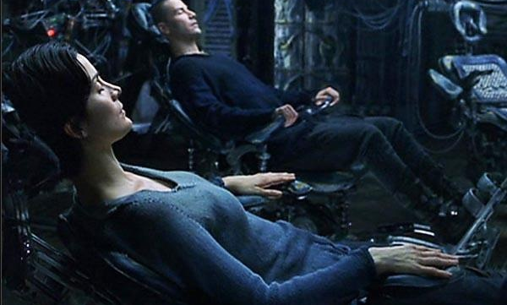
Becoming a pythonista
I wish I could download everything
I know directly into your brain
A la the matrix, but I can’t
I can help you get started
Lets see how far the rabbit hole goes..

Slide 8
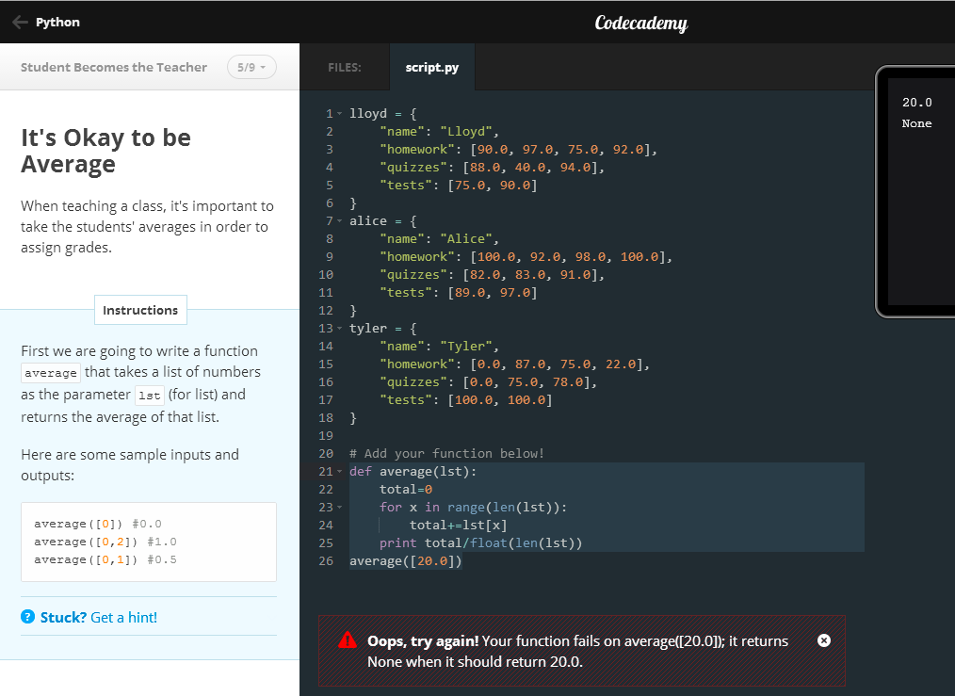
Learning python online: code academy
Learn to use python effectively
Learn to write programs interactively line by line
Learn good programming practices
Helpful feedback, and forums if you get stuck
Its fun! ☺

Slide 9
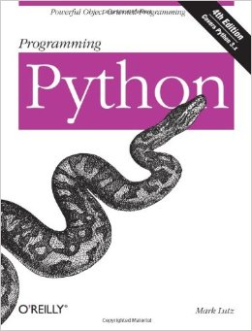
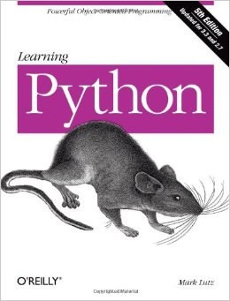
Online Resources @ yale
You can read these books in their entirety for free!
Go to orbis.library.yale.edu/ to search for electronic versions of these
And other books. O’Reilly publishes great programing books

Slide 10
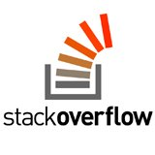
Other resources
Someone may have had the same problem you are having
Read through or search forums to look for helpful tips
Ask your friends around you for help, they may know a quick fix or have a pro tip

Slide 11
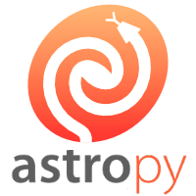
Python for astronomers
Many tools are helpful for scientific computing
Numpy, scipy, pandas, matplotlib
Pyraf and other wrappers for python
Astropy
Go to http://www.astrobetter.com/blog/2011/05/25/python4astronomers/ for an intro tutorial on using python in astronomy

